Slide 1
2023 Maryland – DC Section Simulated Emergency Test Road Show – CALV ARES
Jim Montgomery
WB3KAS
American Radio Relay League
Atlantic Division
Maryland-DC Section
Section Emergency Coordinator
wb3kas@.arrl.net
240-398-1051 C
301-782-7039 H

Slide 2
Meeting Agenda
Introductions
Purpose of SET
General
MDC Section
MDC SET Details
Graphic Summary
ARRL Reporting Requirements
Last minute updates, if any
Challenges

Slide 3
Introductions

Slide 4
MDC Section SET Planning Team
AB3WG Chris MDC SM
WB3KAS Jim MDC SEC (Lead)
KG4WWH Adam ASEC
KC3IEI Nate ASEC
KC3VJS Doug BWA

Slide 5
Purpose of SET − General
“A nationwide exercise in emergency communications”
Discover strengths and weakness
Build on strengths and mitigate weaknesses
Test EmComm under close-to-realistic conditions
Stress systems under heavy “traffic loads”
Practice working through the “confusion factor”
Prepare for the, long overdue ‘big one’

Slide 6
Example of Possible Traffic
Loads and the Confusion factor

Slide 7
April Operation Tsunami Comms Hospital Plan
WN3R-10 Digi
145.770
LRH
[WI3N]
BHC
[N3CK]
(P2P)
(P2P)
(P2P)
FRED
ARES
[ ? ]
DECT
[ ? ]
(P2P)
WinMOR
3575KHz
W3CB
3575KHz
WinMOR
3575KHz
CARO
[N3TCR]
(P2P)
DCH
[WA3YTK]
(P2P)
(P2P)
Origination | Destination | Via
BHC | PGCHD | Direct on 144
CARO cnty | KA3AHI | W3CB PGCHDARES EOCKA3AHI
DECT | KA3AHI PGC HD | LRHDCHARES EOCKA3AHI W3CBPGCHD
DCH | PGCHD | Direct on 220
FRED ARES | PGCHD | WN3R-10DECTW3CBPGCHD
FWMC | PGCHD | MSMHCPGCHD
LRH | MNB PGCHD | Direct on 144 PGHCPGCHD
MSMHC | PGCHD | Direct on 144
PGHC | PGCHD | Direct on 440
MNB
[KB3ZCO]
PGC EOC
[KB3IIE]
3575KHz
(P2P)
220
(P2P)
PGHC
[N3ADF]
Health Dept
[AB3NA]: 144
[N3XL]: 220
[KA4TMB]:440
(P2P)
440
ARES EOC
ICS
[WB3KAS]
KA3AHI
(P2P)
Notes:
All P2P frequencies are on 144 except as noted.
P2P receive frequencies
are posted in the PRGE
ARES ICS-205 Plan
MSMHC
[WB2IFS]
FWMC
[FWARC]
[ ? ]
(P2P)
2015-04 ARES Hosp Drill Layout.pptx

Slide 8
Difference between FD and SET
Field Day emphasis on
Operating Skills
One mission: 24hr ops
Exploring new modes
Adapting equipment
New/different antennas
Operate from a single site
Test alternatives to commercial power
Set up 24 hrs prior

Slide 9
Difference between FD and SET
Field Day emphasis on
Operating Skills
One mission: 24hr ops
Exploring new modes
Adapting equipment
New/different antenna
Operate from a single site
Test alternatives to commercial power
Set up 24 hrs prior
Simulated Emergency Test emphasis on
Gain experience in a simulated disaster
Determine strong points; eliminate weak points discovered
Strengthen VHF-to HF links at the local level
You do for your Agency
Last minute Deployment

Slide 10
Purpose of SET − MDC Section
Exercise a Deployment
Response readiness
Many have never done
What does it take?
Think outside the box
Cliché, I know but. . .
You don’t know, what you don’t know. . .do you?

Slide 11
2023 MDC SET “The Sequel”
2013 graced by Hurricane Chessie –no deployment
2014 provided supplies to a Relocated MDEM as a result of a Tornado - deployment
2015 a continuation: MDEM request to check Section Water Level Gauges following a storm- deployment
2017 Eastern Shore Deployment at MDEM’s request of for Hurricane Elmer
2023 Exploring the United States National Geodetic Survey Markers - deployment

Slide 12
Why Are We Chasing Geodetic Markers?
An opportunity for a deployment
We don’t get opportunities
Gives you a chance to function in small teams
Fine tunes the buddy system approach
Keeps you up to date in APRS functionality
Did this in 2015 and received rave reviews
Gets you out of the house

Slide 13
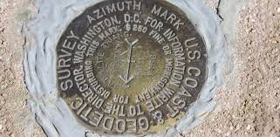
When, where, who, what, etc?
Saturday October 7, 2023 (~0900 – ~1500)
Maryland Statewide and DC
ARES, RACES, Clubs anyone interested
NOAA requests help in checking the quality and accountability of Markers
NOAA's National Geodetic Survey responsible for managing about 240,000 ‘Markers’ gathered over the last 200 years

Slide 14
2023 SET Details
Thursday Night October 5
NOAA requesting Amateur Radio support
To survey as many Markers as feasible
And report back
Friday Morning October 6
SEC calls up all the Section DECs to assist
Echolink meeting 8pm (Wash Conf Node?)
Finalize deployment details
APRS and WL2K call signs and teams

Slide 15
Pre-Ops Concept
Amateur Radio Community Outreach
ARES
RACES
ACS
Clubs
MARS
At your August/September meeting(s)
Invite others
Talk it up
Assign buddy systems and who goes where

Slide 16
Where Do You Find the List?
National Geodetic Survey OPUS Share Map
https://www.ngs.noaa.gov/opusmap/
You will see a map of the USA
Showing clusters with number of Markers
Continue clicking on the ball of interest until a zoomed-in map appears

Slide 17
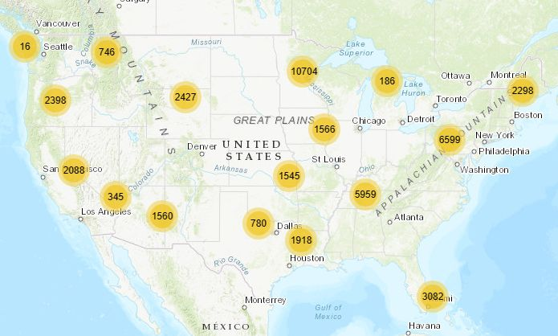
Selected MDC Section
Survey Markers

Slide 18
Selected MDC Section
Survey Markers

Slide 19
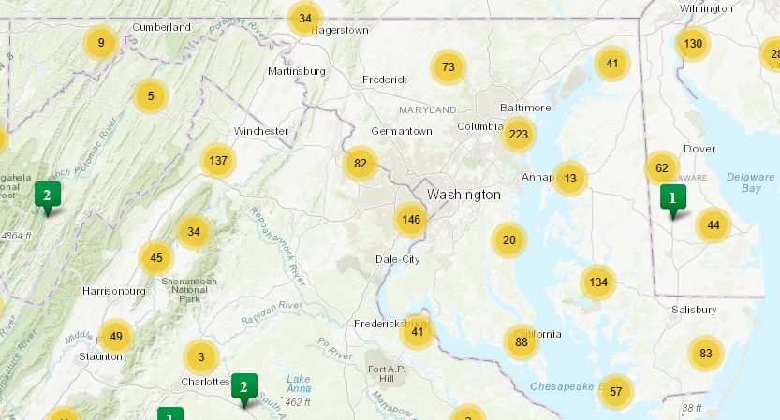
Selected MDC Section
Survey Markers

Slide 20
Selected MDC Section
Survey Markers

Slide 21
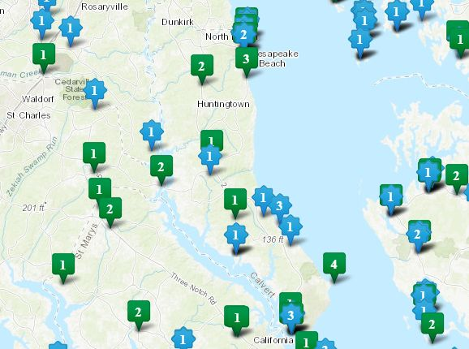
Selected MDC Section
Survey Markers

Slide 22
Selected MDC Section
Survey Markers

Slide 23
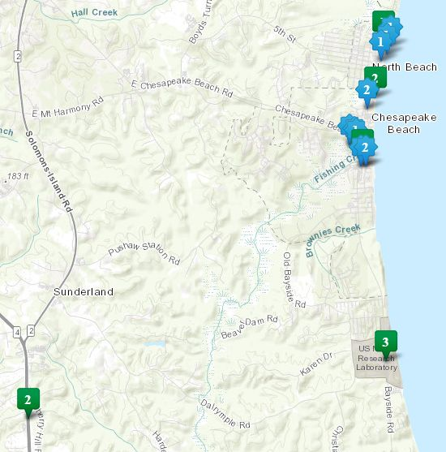
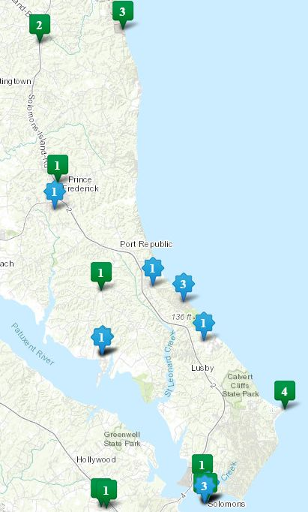
Selected MDC Section
Survey Markers
North
County
South
County

Slide 24
Selected MDC Section
Survey Markers
North
County
South
County

Slide 25
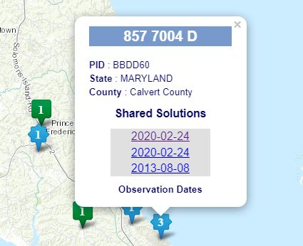
Selected MDC Section
Survey Markers
Click on the
latest date

Slide 26
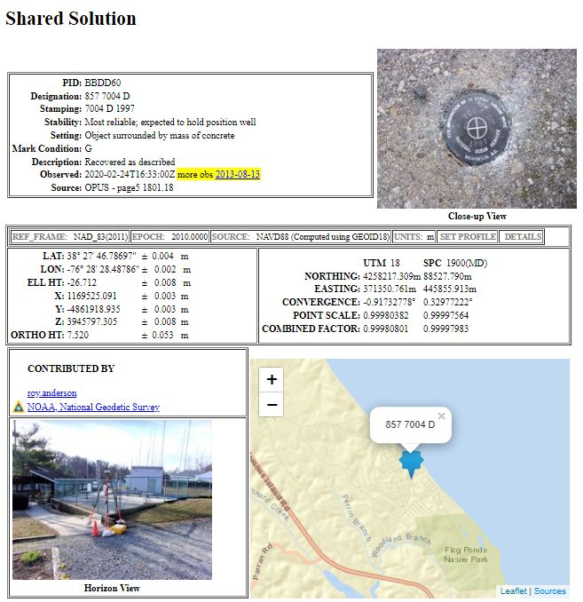
Selected MDC Section
Survey Markers

Slide 27
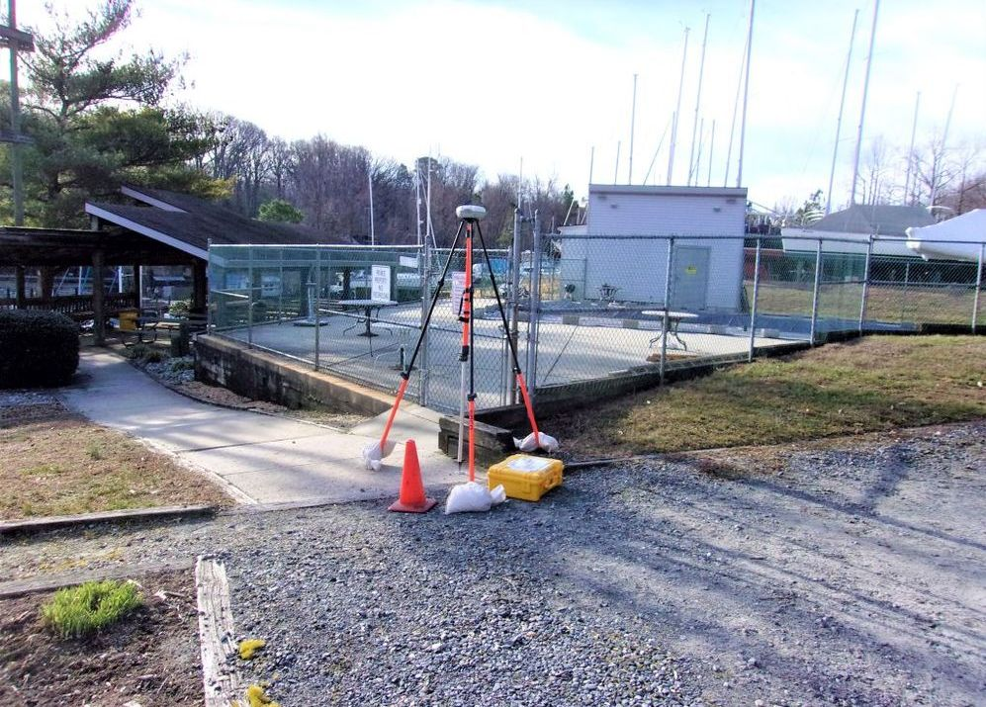
Selected MDC Section
Survey Markers

Slide 28
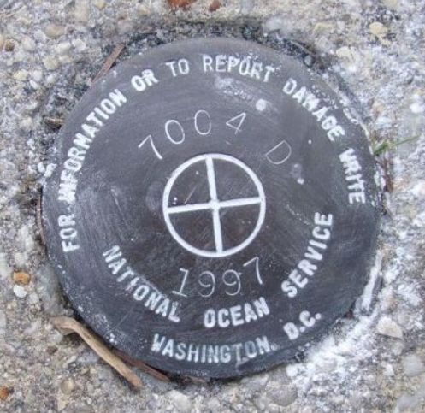
Selected MDC Section
Survey Markers

Slide 29
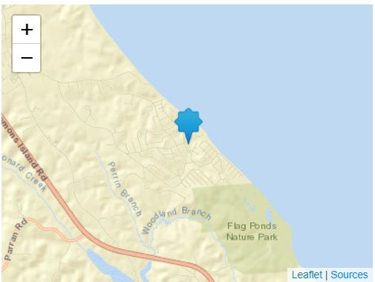
Selected MDC Section
Survey Markers

Slide 30
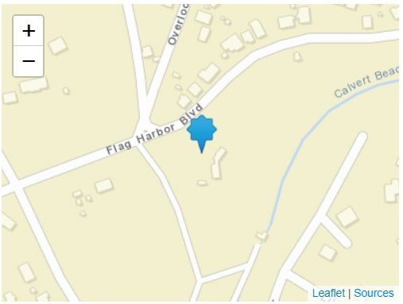
Selected MDC Section
Survey Markers

Slide 31
Initial Marker Observations
WASH
EOC
GARR
EOC
HARF
EOC
FRED
EOC
HOWA
EOC
MONT
EOC
Survey Teams report Marker observations to their local EOCs, or some central location
PRGE
EOC
TALB
EOC
CHAS
EOC
CALV
EOC

Slide 32
Secondary Reports to DECs
WDEC
WASH
EOC
GARR
EOC
HARF
EOC
FRED
EOC
CDEC
MONT
EOC
ECs in their District send Summary
Marker reports to their District ECs
via Winlink
PRGE
EOC
EDEC
CHAS
EOC
CALV
EOC

Slide 33
DEC Reports to MDC SEC
WDEC
CDEC
DECs send their Summary
Marker reports to MDC SEC
via Winlink
MDC
SEC
EDEC

Slide 34
Communications
Voice Circuits (Local):
Local within your county use your repeaters
Tracking
APRS “RADAR” on 144.39 CTCSS 100.0
Beacon 1/min & TURN UP THE VOLUMN!
Digital Traffic:
Your mode of choice within your jurisdiction
WL2K P2P : 7.075MHz and/or 3.575 MHz (USB)
WL2K Vara: Your gateway of choice

Slide 35
Communications
Restrictions
Begin and end every communication with:
“This is a drill, this is a drill”
Traffic to the SEC at Command Central (MDCSEC)
Repeaters are functional
Packet Nodes are playing, but limited in number
Follow “comm chain of command”
Reply to originator unless otherwise told
Be mindful of ‘copy to’ traffic

Slide 36
Safety First
There should not be any Markers selected to be of any danger to you
Be mindful of vehicle traffic
Driver does not leave the vehicle
Wear your ARES yellow vest and hard hat
Have the SET Plan on a clipboard
Looks professional!
Everybody will get home safely

Slide 37
Cautions & Recommendations
Be quick about your business
One person takes photos
Take several photos with cell phone; send the best
The other verifies GPS coordinates from cellphone app or handheld GPS device

Slide 38
ARRL SET Reporting
 | Computation of Score | Qty | Multiplier | Points
A | Number participated: |  | X2
B | Number new hams (licensed since 2010) |  | X3
C | Number formal 3rd party written traffic messages originated or delivered during SET on behalf of served agencies |  | X1
D | Were TACTICAL comms conducted on behalf of served agencies? (1 hr or more, 20 pts; ½ - 1 hr, 10; less tha ½, 5 pts) |  | N/A
E | Number of stations on emergency power during SET |  | X2
F | Number of emergency powered repeaters used during SET Give repeater call signs: |  | X10
G | Is dual membership in ARES & RACES actively encouraged? 10 pts if YES.
H | Was liaison maintained during SET with NTS section or local Net? If YES, score 10 pts. Give call signs of liaison station(s)
I | Were digital modes utilized at any time during SET? If YES, score 10 pts. Names the digital modes utilized:
J | Number of different agencies for which comms were handled? |  | X5
K | Number of communities in which agencies were conducted. (If none, score minus 10 pts). List communities served: |  | X10
L | Was a press release submitted? If YES, score 10 pts and attached a copy
M | Bonus: New for 2015??? |  | X3
 | Total

Slide 39
APRS & WL2K Working Together
A Graphical Summary

Slide 40
Caution
What You are About to See May
Seem Extremely Graphical

Slide 41
Maryland – DC Section
WDEC
WL2K
CDEC
WL2K
MDC
SEC
WL2K
EDEC
WL2K messages go out to
all three DECs requesting
assistance to support the
State.

Slide 42
Maryland – DC Section
WDEC
CDEC
EDEC
MDC
SEC
Data sent to
DECs And MDC SEC
via WL2K Vara HF
P2P: 7075KHz/3575KHz
Maybe??

Slide 43
Maryland – DC Section
N3TCR
????
APRS Tracking
West: N3TCR
Cent: ????
East: W3GAC
MDC
SEC
W3GAC
Needs
updating

Slide 44
Known Players as of Friday Night (2015)
GARR
ALLE
WASH
MONT
ANAR
CARO
PRGE
CHAS
CALV

Slide 45
Known Players as of August 15, 2015 Planning Meeting
GARR
ALLE
WASH
CARR
CECI
MONT
ANAR
CARO
Two a additional counties
Added : CARR & CECI
PRGE
CHAS
CALV
STMA

Slide 46
Challenges/Issues
?

